Slide 1
4: Explore fundamentals of data analytics

Slide 2





Agenda
Large-scale data warehousing
Streaming and real-time analytics
Data visualization
Notes:
This should take approximately 150 minutes (2.5 hours) to deliver, including the three lab exercises.

Slide 3
1: Large-scale data warehousing

Slide 4
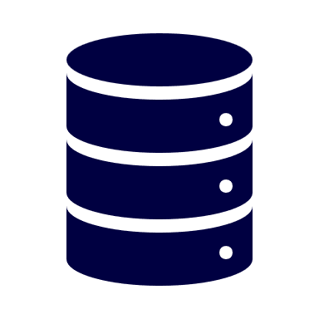
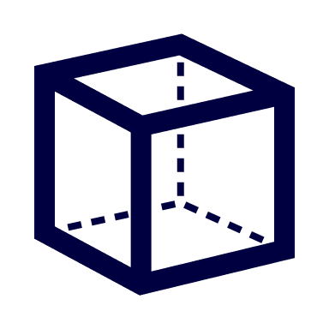







What is large-scale data warehousing?
Data ingestion and processing
Analytical data store
Analytical data model
Data visualization
----
----
----
Extract, Transform, and Load (ETL) or Extract, Load, and Transform (ELT) orchestration
Distributed processing to cleanse and restructure data at scale
Batch and real-time data processing
Denormalized relational data storage in a data warehouse
Semi-structured file storage in a data lake
Semantic models for analytical entities
Often in the form of aggregated cubes that summarize numeric values across one or more dimensions
Reports
Charts
Dashboards
Notes:
Large-scale data warehousing is a generic term that describes the infrastructure and processes used to support large-scale data analytics. Large-scale data warehousing solutions combine conventional data warehousing used to support business intelligence (BI) - which typically involves copying data from transactional data stores into a relational database with a schema that's optimized for querying and building multidimensional models; with techniques used for so-called "big data" analytics, in which large volumes of data in multiple formats are batch loaded or captured in real-time streams, and stored in a data lake from which distributed processing engines like Apache Spark are used to process the data at scale.
Large-scale data warehousing architecture can vary, as can the specific technologies used to implement it; but in general, the following components are included:
Data ingestion and processing – data from one or more transactional data stores, files, real-time streams, or other sources is loaded into a data lake or a relational data warehouse. The load operation usually involves an extract, transform, and load (ETL) or extract load and transform process in which the data is cleaned, filtered, and restructured for analysis. In ETL processes, the data is transformed before being loaded into an analytical store, while in an ELT process the data is copied to the store and then transformed. Either way, the resulting data structure is optimized for analytical queries. The data processing is often performed by distributed systems that can process high volumes of data in parallel using multi-node clusters. Data ingestion includes both batch processing of static data and real-time processing of streaming data.
Analytical data store – data stores for large scale analytics include relational data warehouses, file-system based data lakes, and hybrid architectures that combine features of data warehouses and data lakes (sometimes called Data Lakehouses or Lake Databases). We'll discuss these in more depth later.
Analytical data model – while data analysts and data scientists can work with the data directly in the analytical data store, it’s common to create one or more data models that pre-aggregate the data to make it easier to produce reports, dashboards, and interactive visualizations. Often these data models are described as cubes, in which numeric data values are aggregated across one or more dimensions (for example, to determine total sales by product and region). The model encapsulates the relationships between data values and dimensional entities to support "drill-up/drill-down" analysis.
Data visualization – data analysts consume data from analytical models, and directly from analytical stores to create reports, dashboards, and other visualizations. Additionally, users in an organization who may not be technology professionals might perform self-service data analysis and reporting. The visualizations from the data show trends, comparisons, and key performance indicators (KPIs) for a business or other organization, and can take the form of printed reports, graphs and charts in documents or PowerPoint presentations, web-based dashboards, and interactive environments in which users can explore data visually.

Slide 5



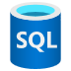


Data ingestion and processing pipelines
Create pipelines in Azure Data Factory or Azure Synapse Analytics
Pipeline
Input dataset
Activities
Output dataset
Linked services
Notes:
Now that you understand a little about the architecture of a large-scale data warehousing solution, and some of the distributed processing technologies that can be used to handle large volumes of data, it's time to explore how data is ingested into an analytical data store from one or more sources.
On Azure, large-scale data ingestion is best implemented by creating pipelines that orchestrate ETL processes. You can create and run pipelines using Azure Data Factory, or you can use the same pipeline engine in Azure Synapse Analytics if you want to manage all of the components of your data warehousing solution in a unified workspace.
In either case, pipelines consist of one or more activities that operate on data. An input dataset provides the source data, and activities can be defined as a data flow that incrementally manipulates the data until an output dataset is produced. Pipelines use linked services to load and process data – enabling you to use the right technology for each step of the workflow. For example, you might use an Azure Blob Store linked service to ingest the input dataset, and then use services such as Azure SQL to run a stored procedure that looks up related data values, before running a data processing task on Azure Databricks or Azure HDInsight, or apply custom logic using an Azure Function. Finally, you can save the output dataset in a linked service such as Azure Synapse Analytics. Note that pipelines can support some built-in activities, which don’t require a linked service.

Slide 6



Analytical data stores
Data Warehouse
Data Lake
Large-scale relational database store and query engine
Data is denormalized for query optimization
Typically as a star or snowflake schema of numeric facts that can be aggregated by dimensions
Data files are stored in a distributed file system
Tabular storage layers can be used to abstract files and provide a relational interface.
Use PolyBase external tables or create a lake database in Azure Synapse Analytics
Use database tables and SQL endpoints in Azure Databricks
Use Spark Delta Lake to add relational storage semantics and create a data lakehouse in Azure Synapse Analytics, Azure Databricks, and Azure HDInsight
Notes:
As previously discussed, there are three common ways to implement an analytical data store.
A data warehouse is a relational database in which the data is stored in a schema that is optimized for data analytics rather than transactional workloads. Commonly, the data from a transactional store is denormalized into a schema in which numeric values are stored in central fact tables, which are related to one or more dimension tables that represent entities by which the data can be aggregated. For example a fact table might contain sales order data, which can be aggregated by customer, product, store, and time dimensions (enabling you for example, to easily find monthly total sales revenue by product for each store). This kind of fact and dimension table schema is called a star schema; though it's often extended into a snowflake schema by adding additional tables related to the dimension tables to represent dimensional hierarchies (for example, product might be related to product categories. A data warehouse is a great choice when you have transactional data that can be organized into a structured schema of tables, and you want to use SQL to query them.
A data lake is a file store, usually on a distributed file system for high performance data access. Technologies like Spark or Hadoop are often used to process queries on the stored files and return data for reporting and analytics. These systems often apply a schema-on-read approach to define tabular schemas on semi-structured data files at the point where the data is read for analysis, without applying constraints when it is stored. Data lakes are great for supporting a mix of structured, semi-structured, and even unstructured data that you want to analyze without the need for schema enforcement when the data is written to the store.
You can use a hybrid approach that combines features of data lakes and data warehouses in a *lake database* or *data lakehouse*. The raw data is stored as files in a data lake, and a relational storage layer abstracts the underlying files and expose them as tables, which can be queried using SQL. SQL pools in Azure Synapse Analytics include *PolyBase*, which enables you to define external tables based on files in a datalake (and other sources) and query them using SQL. Synapse Analytics also supports a Lake Database approach in which you can use database templates to define the relational schema of your data warehouse, while storing the underlying data in data lake storage – separating the storage and compute for your data warehousing solution. Data lakehouses are a relatively new approach in Spark-based systems, and are enabled through technologies like *Delta Lake*; which adds relational storage capabilities to Spark, so you can define tables that enforce schemas and transactional consistency, support batch-loaded and streaming data sources, and provide a SQL API for querying.

Slide 7
Choose an analytical data store service
Azure Synapse Analytics
Azure Databricks
Azure HDInsight
Unified solution for relational data warehouse and data lake analytics
Scalable processing and querying through multiple analytics runtimes
Synapse SQL
Apache Spark
Synapse Data Explorer
Interactive experience in Azure Synapse Studio
Built-in pipeline integration for data ingestion and processing
Azure-based implementation of Databricks cloud analytics platform
Scalable Spark and SQL querying for data lake analytics
Interactive experience in Azure Databricks workspace
Use Azure Data Factory to implement data ingestion and processing pipelines
Azure-based implementation of common Apache "big data" frameworks built on a data lake
Hadoop - Query data lake files using Hive tables
Spark – Use Spark APIs to query data, and abstract underlying file storage as tables
Kafka – Real-time event processing
Storm – Stream processing
HBase – NoSQL data store
Use for a single, unified large-scale analytical solution on Azure
Use to leverage Databricks skills and for cloud portability
Use when you need to support multiple open-source platforms
Notes:
On Azure, there are three main services that you can use to implement a large-scale analytical store.
Azure Synapse Analytics is a unified, end-to-end solution for large scale data analytics. It brings together a number of technologies and capabilities, enabling you to combine the data integrity and reliability of a scalable, high-performance SQL Server based relational data warehouse with the flexibility of a data lake and open-source Apache Spark. It also includes native support for log and telemetry analytics with Azure Synapse Data Explorer pools, as well as built in data pipelines for data ingestion and transformation. All Azure Synapse Analytics services can be managed through a single, interactive user interface called Azure Synapse Studio, which includes the ability to create interactive notebooks in which Spark code and markdown content can be combined. Synapse Analytics is a great choice when you want to create a single, unified analytics solution on Azure.
Azure Databricks is an Azure implementation of the popular Databricks platform. Databricks is a comprehensive data analytics solution built on Apache Spark, which offers native SQL capabilities as well as workload-optimized Spark runtimes for data analytics and data science, and an interactive user interface through which the system can be managed and data can be explored in interactive notebooks. Due to its common use on multiple cloud platforms, you might want to consider using Azure Databricks as your analytical store if you want to leverage existing expertise with the platform or if you need to operate in a multi-cloud environment or support a cloud-portable solution.
Azure HDInsight is an Azure service that supports mulitple open-source data analytics cluster types. Although not as user-friendly as Azure Synapse Analytics and Azure Databricks, it can be a suitable option if your analytics solution relies on multiple open-source frameworks or if you need to migrate an existing on-premises Hadoop-based solution to the cloud.

Slide 8
Lab: Explore Azure Synapse Analytics
In this lab, you will provision an Azure Synapse Analytics workspace, and use it to ingest and process data
Start the virtual machine for this lab
or go to the exercise page at https://aka.ms/dp900-synapse-lab
Follow the instructions to complete the exercise on Microsoft Learn
Use the Azure subscription provided for this lab
Notes:
If necessary, demonstrate how to sign into the lab virtual machine and follow the instructions there. If you’re not using a lab VM, students can follow the instructions in the GitHub page for this lab.
Students should use the Azure subscription credentials provided to them. The lab is also available from the related module on Microsoft Learn, so students can complete it later if desired; but they will need to provide their own Azure subscription to do so.

Slide 9

1: Knowledge check
Which Azure services can you use to create a pipeline for data ingestion and processing?
Azure SQL Database and Azure Cosmos DB
Azure Synapse Analytics and Azure Data Factory
Azure HDInsight and Azure Databricks
What must you define to implement a pipeline that reads data from Azure Blob Storage?
A linked service for your Azure Blob Storage account
A dedicated SQL pool in your Azure Synapse Analytics workspace
An Azure HDInsight cluster in your subscription
Which open-source distributed processing engine does Azure Synapse Analytics include?
Apache Hadoop
Apache Spark
Apache Storm
Notes:
Allow students a few minutes to think about the questions, and then use the animated slide to reveal the correct answers.

Slide 10
2: Streaming and real-time analytics

Slide 11
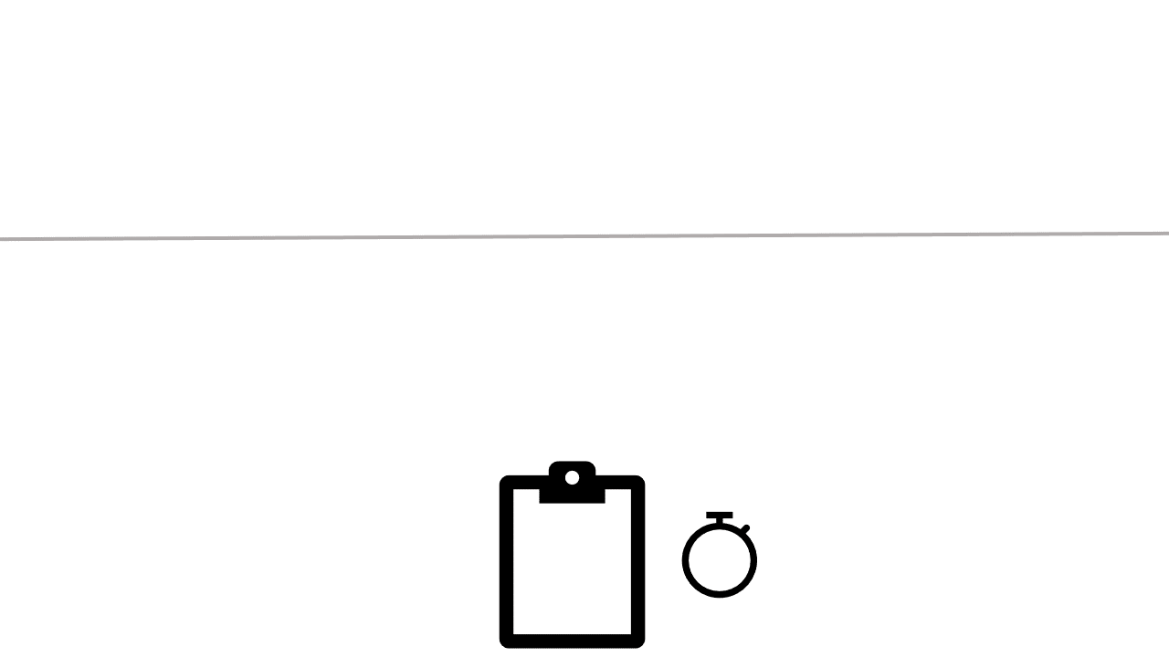
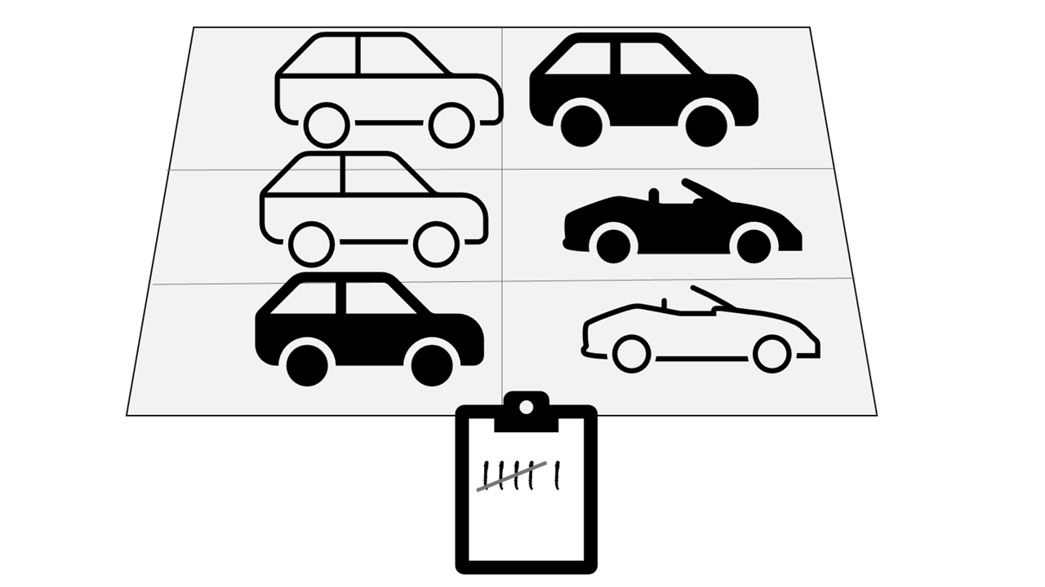
Batch vs stream processing
Batch processing
Stream processing
Data is collected and processed at regular intervals
Data is processed in (near) real-time as it arrives
Notes:
Data processing is simply the conversion of raw data to meaningful information through a process. There are two general ways to process data:
Batch processing, in which multiple data records are collected and stored before being processed together in a single operation.
Stream processing, in which a source of data is constantly monitored and processed in real time as new data events occur.
In batch processing, newly arriving data elements are collected into a group. The whole group is then processed at a future time as a batch. Exactly when each group is processed can be determined in a number of ways. For example, you can process data based on a scheduled time interval (for example, every hour), or it could be triggered when a certain amount of data has arrived, or as the result of some other event.
For example, suppose you want to analyze road traffic by counting the number of cars on a stretch of road. A batch processing approach to this would require that you collect the cars in a parking lot, and then count them in a single operation while they're at rest.
In stream processing, each new piece of data is processed when it arrives. Unlike batch processing, there's no waiting until the next batch processing interval - data is processed as individual units in real-time rather than being processed a batch at a time. Streaming data processing is beneficial in most scenarios where new, dynamic data is generated on a continual basis.
For example, a better approach to our hypothetical car counting problem might be to apply a streaming approach, by counting the cars in real-time as they pass:
In this approach, you don't need to wait until all of the cars have parked to start processing them, and you can aggregate the data over time intervals; for example, by counting the number of cars that pass each minute.
Many large-scale analytics solutions include a mix of batch and stream processing, enabling both historical and real-time data analysis. It's common for stream processing solutions to capture real-time data, process it by filtering or aggregating it, and present it through real-time dashboards and visualizations (for example, showing the running total of cars that have passed along a road within the current hour), while persisting the processed results in a data store for historical analysis alongside batch processed data (for example, to enable analysis of traffic volumes over the past year).

Slide 12




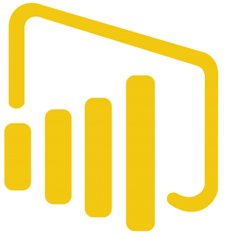
Real-time data processing with Azure Stream Analytics
Create an individual Azure Stream Analytics job or an Azure Stream Analytics cluster
Ingest data from an input, such as:
Azure Event Hubs
Azure IoT Hub
Azure Blob Storage
…
Process data with a perpetual query
Send results to an output, such as:
Azure Blob Storage
Azure SQL Database
Azure Synapse Analytics
Azure Function
Azure Event Hubs
Power BI
…
Azure Stream Analytics Job
Input
SELECT …
Output
Query
Notes:
Azure Stream Analytics is a service for complex event processing and analysis of streaming data. Stream Analytics is used to:
Ingest data from an input, such as an Azure event hub, Azure IoT Hub, or Azure Storage blob container.
Process the data by using a query to select, project, and aggregate data values.
Write the results to an output, such as Azure Data Lake Gen 2, Azure SQL Database, Azure Synapse Analytics, Azure Functions, Azure event hub, Microsoft Power BI, or others.
Once started, a Stream Analytics query will run perpetually, processing new data as it arrives in the input and storing results in the output.
The easiest way to use Azure Stream Analytics is to create a Stream Analytics job in an Azure subscription, configure its input(s) and output(s), and define the query that the job will use to process the data. The query is expressed using structured query language (SQL) syntax and can incorporate static reference data from multiple data sources to supply lookup values that can be combined with the streaming data ingested from an input.
If your stream process requirements are complex or resource-intensive, you can create a Stream Analysis cluster, which uses the same underlying processing engine as a Stream Analytics job, but in a dedicated tenant (so your processing is not affected by other customers) and with configurable scalability that enables you to define the right balance of throughput and cost for your specific scenario.

Slide 13

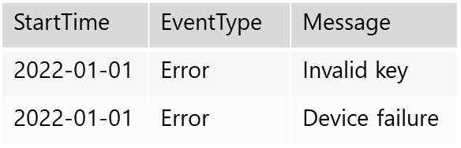
Real-time log and telemetry analysis with Azure Data Explorer
High throughput, scalable service for batch and streaming data
Azure Data Explorer dedicated service
Azure Synapse Data Explorer runtime in Azure Synapse Analytics
Data is ingested from streaming and batch sources into tables in a database
Tables can be queried using Kusto Query Language (KQL):
Intuitive syntax for read-only queries
Optimized for raw telemetry and time-series data
LogEvents
…
…
LogEvents
| where StartTime > datetime(2021-12-31)
| where EventType == 'Error'
| project StartTime, EventType , Message
Notes:
Azure Data Explorer is a standalone Azure service for efficiently analyzing data. The service is also encapsulated as a runtime in Azure Synapse Analytics, where it is referred to as Azure Synapse Data Explorer; enabling you to build and manage analytical solutions that combine SQL, Spark and Data Explorer analytics in a single workspace.
Data is ingested into Data Explorer through one or more connectors or by writing a minimal amount of code. This enables you to quickly ingest data from a wide variety of data sources, including both static and streaming sources. The ingested data is stored in tables in a Data Explorer database, where automatic indexing enables high-performance queries.
To query the tables, you can use Kusto Query Language (KQL), a language that is specifically optimized for fast read performance – particularly with telemetry data that includes a timestamp attribute, such as log files or internet-of-things (IoT) device messages.
To learn more about Azure Data Explorer, see https://docs.microsoft.com/learn/modules/intro-to-azure-data-explorer/intro-to-azure-data-explorer/ (note that this Learn module is not part of the official course materials for this course – it supports further learning beyond the scope of the Data Fundamentals certification).

Slide 14
Lab: Analyze streaming data
In this lab, you will use Azure Stream Analytics to process a real-time data stream
Start the virtual machine for this lab
or go to the exercise page at https://aka.ms/dp900-stream-lab
Follow the instructions to complete the exercise on Microsoft Learn
Use the Azure subscription provided for this lab and a cloud shell in the Azure portal
Notes:
If necessary, demonstrate how to sign into the lab virtual machine and follow the instructions there. If you’re not using a lab VM, students can follow the instructions in the GitHub page for this lab.
Students should use the Azure subscription credentials provided to them. The lab (along with others) is also available from the related module on Microsoft Learn, so students can complete it later if desired; but they will need to provide their own Azure subscription to do so.

Slide 15
2: Knowledge check
Which definition of stream processing is correct?
Data is processed continually as new data records arrives
Data is collected in a temporary store, and all records are processed together as a batch
Data is incomplete and cannot be analyzed
Which service would you use to continually capture data from an IoT Hub, aggregate it over temporal periods, and store results in Azure SQL Database?
Azure Cosmos DB
Azure Stream Analytics
Azure Storage
Which language would you use to query real-time log data in Azure Synapse Data Explorer?
SQL
Python
KQL
Notes:
Allow students a few minutes to think about the questions, and then use the animated slide to reveal the correct answers.

Slide 16
3: Data visualization

Slide 17
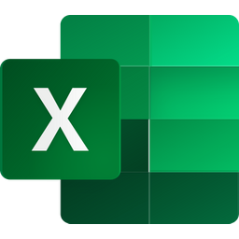







Introduction to data visualization with Power BI
Start with Power BI Desktop
Import data from one or more sources
Define a data model
Create visualizations in a report
Publish to Power BI Service
Schedule data refresh
Create dashboards and apps
Share with other users
Interact with published reports
Web browser
Power BI phone app
Web Browser
Power BI Service
Power BI Desktop
Power BI Phone App
Notes:
Data modelling and visualization is at the heart of "business intelligence" (BI) workloads that are supported by large-scale data analytics solutions.
Microsoft Power BI is a suite of tools and services that data analysts can use to build interactive data visualizations for business users to consume.
A typical workflow for creating a data visualization solution starts with Power BI Desktop, a Windows based application in which you can import data from a wide range of data sources, combine and organize the data from these sources in an analytics data model, and create reports that contain interactive visualizations of the data.
After you've created data models and reports, you can publish them to the Power BI service; a cloud service in which reports can be published and interacted with by business users. You can also do some basic data modeling and report editing directly in the service using a web browser, but the functionality for this is limited compared to the Power BI Desktop tool. You can use the service to schedule refreshes of the data sources on which your reports are based, and to share reports with other users. You can also define dashboards and apps that combine related reports in a single, easy to consume location.
Users can consume reports, dashboards, and apps in the Power BI service through a web browser, or on mobile devices by using the Power BI phone app.

Slide 18
Analytical data modeling
Total revenue for wrenches sold to Samir in January
Customer (dimension)
Key | Name | Address | City
1 | Joe | 1 Main St. | Seattle
2 | Samir | 123 Elm Pl. | New York
3 | Alice | 2 High St. | Seattle
Product (dimension)
Key | Name | Category
1 | Hammer | Tools
2 | Screwdriver | Tools
3 | Wrench | Tools
4 | Bolts | Hardware
∑
Product
Sales (fact)
Key | TimeKey | ProductKey | CustomerKey | Quantity | Revenue
1 | 01012022 | 1 | 1 | 1 | 2.99
2 | 01012022 | 2 | 1 | 2 | 6.98
3 | 02012022 | 1 | 2 | 2 | 5.98
Hammer Wrench Screwdriver
Joe Samir Alice
Customer
Jan Feb Mar Apr May …
Model aggregates measures at each hierarchy level
Time
Measures
Time (dimension)
Key | Year | Month | Day | WeekDay
01012022 | 2022 | Jan | 1 | Sat
02012022 | 2022 | Jan | 2 | Sun
Year | Month | Day | Revenue
2022 |  |  | 8221.48
 | Jan |  | 574.86
 |  | 1 | 9.97
 |  | 2 | 5.98
 |  | … | …
Hierarchy
Notes:
The slide focuses on general concepts – students will see how to work with a model in Power BI in the lab.
Analytical models enable you to structure data to support analysis. Models are based on related tables of data and define the numeric values that you want to analyze or report (known as measures) and the entities by which you want to aggregate them (known as dimensions). For example, a model might include a table containing numeric measures for sales (such as revenue or quantity) and dimensions for products, customers, and time. This would enable you aggregate sale measures across one or more dimensions (for example, to identify total revenue by customer, or total items sold by product per month). Conceptually, the model forms a multidimensional structure, which is commonly referred to as a cube, in which any point where the dimensions intersect represents an aggregated measure for those dimensions.
Tables and schema
Dimension tables represent the entities by which you want to aggregate numeric measures – for example product or customer. Each entity is represented by a row with a unique key value. The remaining columns represent attributes of a entity – for example, products have names and categories, and customers have addresses and cities. It’s common in most analytical models to include a Time dimension so that you can aggregate numeric measures associated with events over time.
The numeric measures that will be aggregated by the various dimensions in the model are stored in Fact tables. Each row in a fact table represents a recorded event that has numeric measures associated with it. For example, the Sales table on the slide represents sales transactions for individual items, and includes numeric values for quantity sold and revenue.
This type of schema, where a fact table is related to one or more dimension tables, is referred to as a star schema (imagine there are five dimensions related to a single fact table – the schema would form a five-pointed star!). You can also define more a complex schema in which dimension tables are related to additional tables containing more details (for example, you could represent attributes of product categories in a separate Category table that is related to the Product table – in which case the design is referred to as a snowflake schema. The schema of fact and dimension tables is used to create an analytical model, in which measure aggregations across all dimensions are pre-calculated; making performance of analysis and reporting activities much faster than calculating the aggregations each time.
Attribute hierarchies
One final thing worth considering about analytical models is the creation of attribute hierarchies that enable you to quickly drill-up or drill-down to find aggregated values at different levels in a hierarchical dimension. For example, consider the attributes in the dimension tables we’ve discussed so far. In the Product table, you can form a hierarchy in which each category might include multiple named products. Similarly, in the Customer table, a hierarchy could be formed to represent multiple named customers in each city. Finally, in the Time table, you can form a hierarchy of year, month, and day. The model can be built with pre-aggregated values for each level of a hierarchy, enabling you to quickly change the scope of your analysis – for example, by viewing total sales by year, and then drilling down to see a more detailed breakdown of total sales by month.
Analytical modeling in Microsoft Power BI
You can use Power BI to define an analytical model from tables of data, which can be imported from one or more data source. You can then use the data modeling interface on the Model tab of Power BI Desktop to define your analytical model by creating relationships between fact and dimension tables, defining hierarchies, setting data types and display formats for fields in the tables, and managing other properties of your data that help define a rich model for analysis.

Slide 19
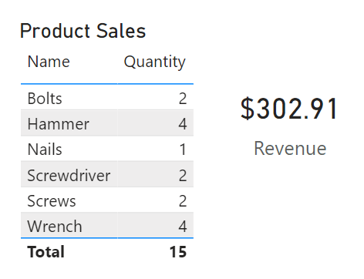
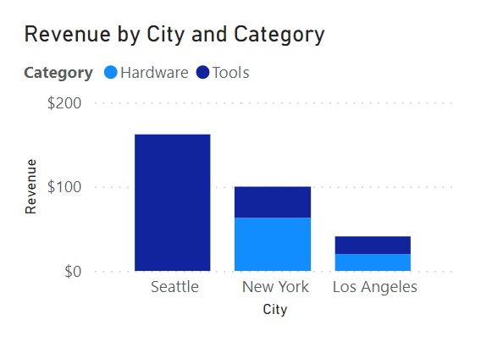
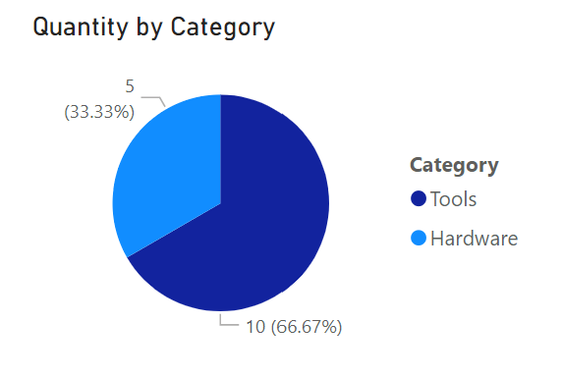
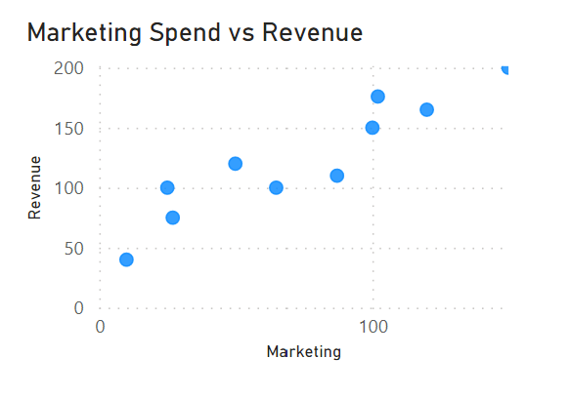
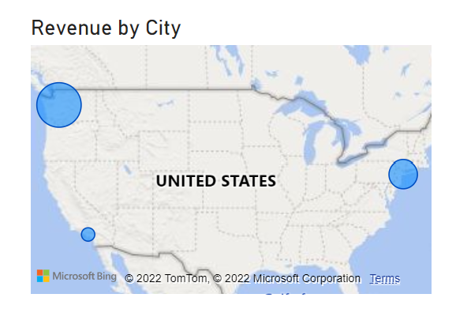

Common data visualizations in reports
Tables and text
Bar or column chart
Line chart
Pie chart
Scatter plot
Map
Notes:
The slide focuses on general concepts – students will see how to use Power BI to create a report with interactive data visualizations in the lab.
After you've created a model, you can use it to generate data visualizations that can be included in a report.
There are many kinds of data visualization, some commonly used and some more specialized. Power BI includes an extensive set of built-in visualizations, which can be extended with custom and third-party visualizations. The slide shows some common data visualizations but is by no means a complete list.
Tables and text are often the simplest way to communicate data. Tables are useful when a lot of related values must be displayed, and individual text values in cards can be a useful way to show important figures or metrics.
Bar and column charts are a good way to visually compare numeric values for discrete categories.
Line charts can also be used to compare categorized values and are particularly useful when you need to examine trends, often over time.
Pie charts are often used in business reports to visually compare categorized values as proportions of a total.
Scatter plots are useful when you want to compare two numeric measures and identify a relationship or correlation between them.
Maps are a great way to visually compare values for different geographic areas or locations.
In Power BI, the visual elements in a report are automatically related to one another and provide interactivity. For example, selecting an individual category in one visual element will automatically filter and highlight that category in other related visualizations in the report.

Slide 20
Lab: Visualize data with Power BI
In this lab, you will use Power BI Desktop to create a data model and a report
Start the virtual machine for this lab
or go to the exercise page at https://aka.ms/dp900-pbi-lab
Follow the instructions to complete the exercise on Microsoft Learn
Use the Azure subscription provided for this lab
Notes:
If necessary, demonstrate how to sign into the lab virtual machine and follow the instructions there. If you’re not using a lab VM, students can follow the instructions in the GitHub page for this lab.
The lab is also available from the related module on Microsoft Learn, so students can complete it later if desired.
This lab does not require an Azure subscription, but it does require that students are using a Windows-based computer on which they can install Power BI Desktop. If the student's own computer is not running Windows, they should complete the lab using the virtual machine.
The download link for Power BI Desktop might need to be copied from the instructions and pasted into the VM browser.

Slide 21
3: Knowledge check
Which tool should you use to import data from multiple data sources and create a report?
Power BI Desktop
Power BI Phone app
Azure Data Factory
What should you define in your data model to enable drill-up/down analysis?
A measure
A hierarchy
A relationship
Which kind of visualization should you use to analyze pass rates for multiple exams over time?
A pie chart
A scatter plot
A line chart
Notes:
Allow students a few minutes to think about the questions, and then use the animated slide to reveal the correct answers.

Slide 22
Further learning
To review what you've learned and do additional labs, review the Microsoft Learn modules for this course:
Explore core data concepts https://aka.ms/ExploreDataConcepts
Explore relational data in Azure https://aka.ms/ExploreRelationalData
Explore non-relational data in Azure https://aka.ms/ExploreNonRelationalData
Explore data analytics in Azure https://aka.ms/ExploreDataAnalytics

Slide 23
Closing slide

